Slide 1
Using veil-framework to Create a Backdoor and Access Victim’s PC

Slide 2

Introduction
Veil Framework
a tool designed to generate metasploit payloads (backdoor) that bypass common anti-virus solutions.
Msfconsole
handles the incoming connection.
a part of Metasploit Framework
Reverse http
victim acts as client. Not the attack.
Backdoor connect to me (attacker) to void anti-virus detection.

Slide 3
Backdoor generation

Slide 4
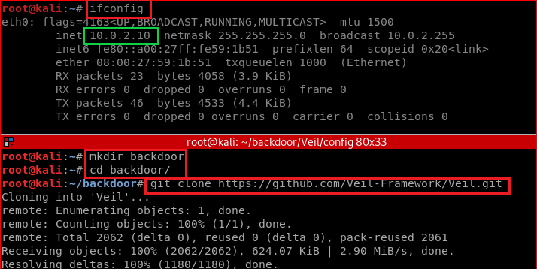
Install Veil in Kali

Slide 5
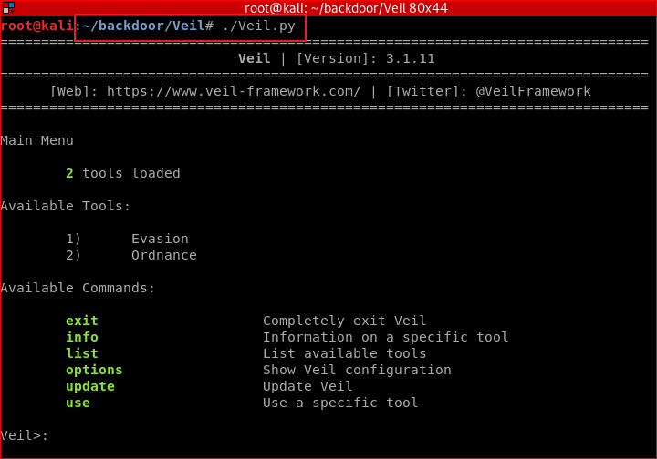
Notes:
./setup.sh --force --silent

Slide 6
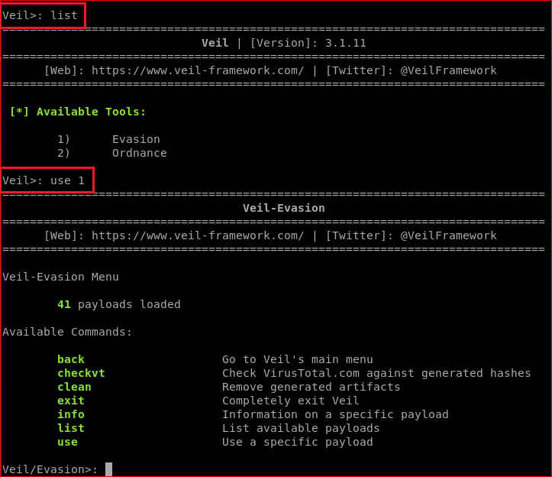
Attacker set payload options using Veil

Slide 7
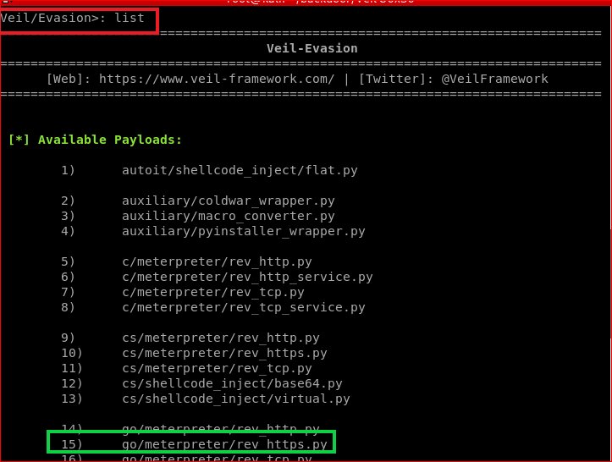

Slide 8
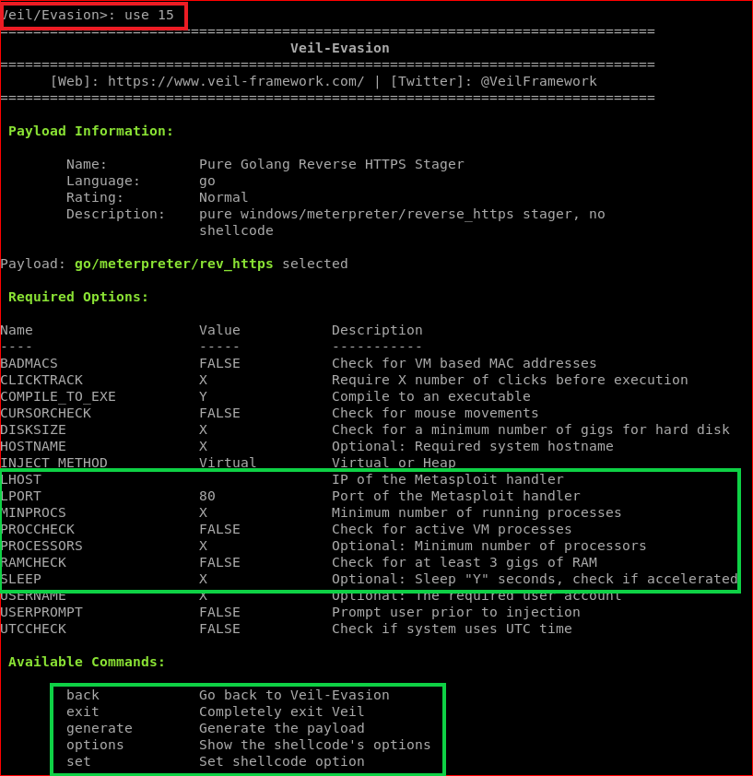

Slide 9
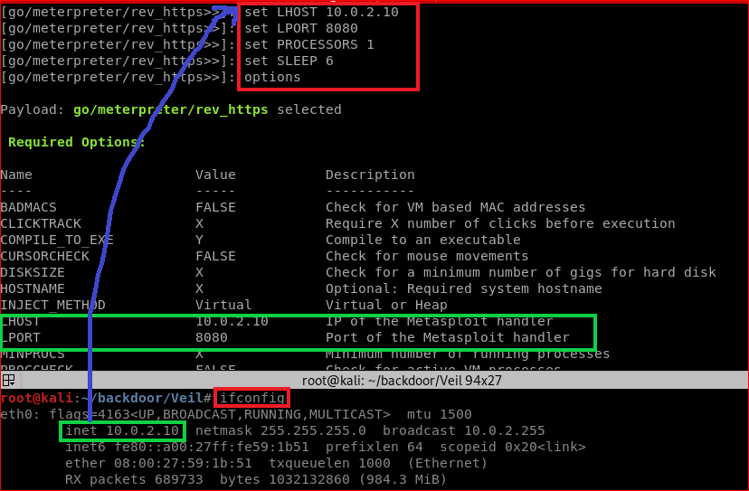

Slide 10
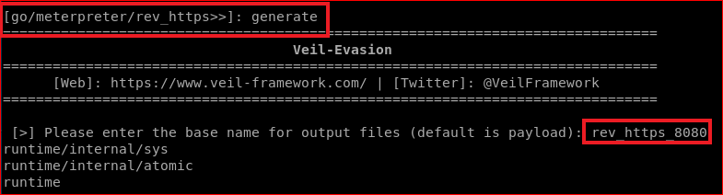
Generate backdoor payload (executable)

Slide 11
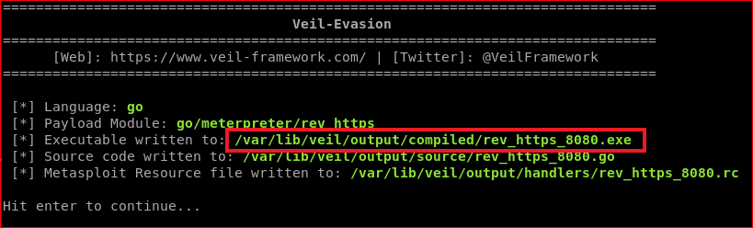
Verify

Slide 12
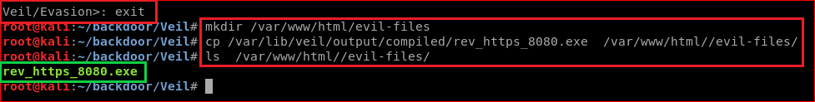
Attacker loads the backdoor to a website
cp /var/lib/veil/output/compiled/rev_https_8080.exe /var/www/html//evil-files/
Notes:
cp /var/lib/veil/output/compiled/rev_https_8080.exe /var/www/html//evil-files/

Slide 13
Gaining Access To Victim's PC

Slide 14
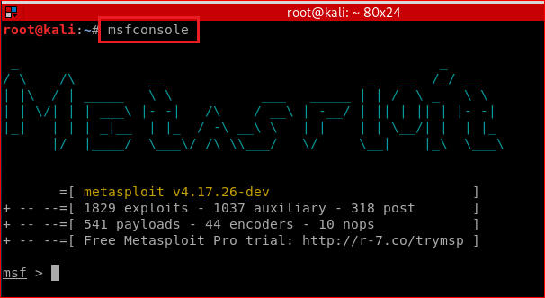
Attacker listening incoming connection (Sever/Attacker side/Kali)

Slide 15
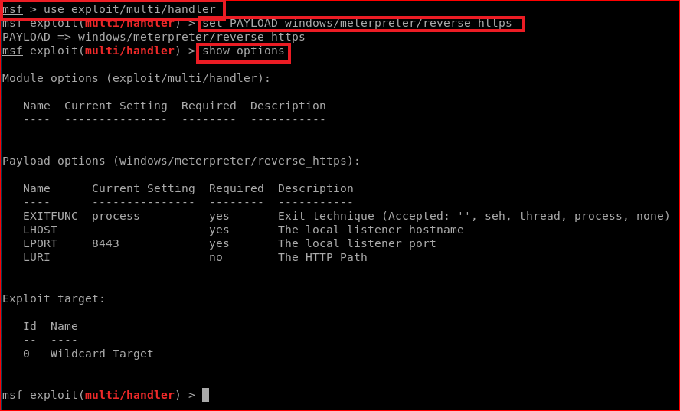
set PAYLOAD

Slide 16
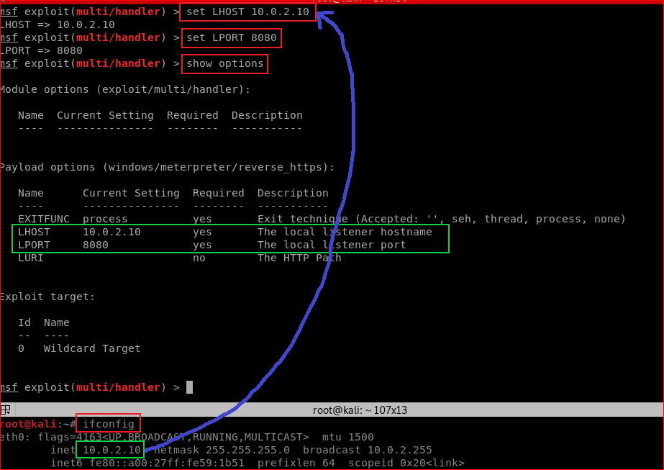

Slide 17
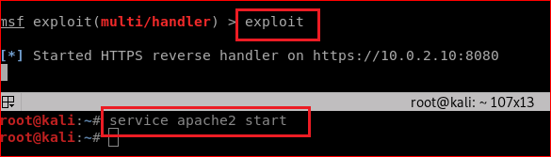

Slide 18
Disable Windows 10 Defender

Slide 19
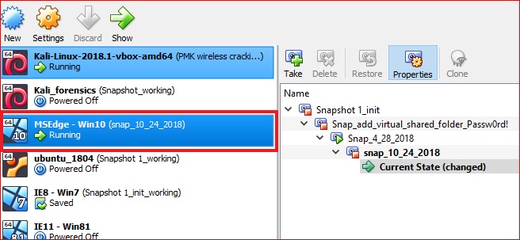

Slide 20
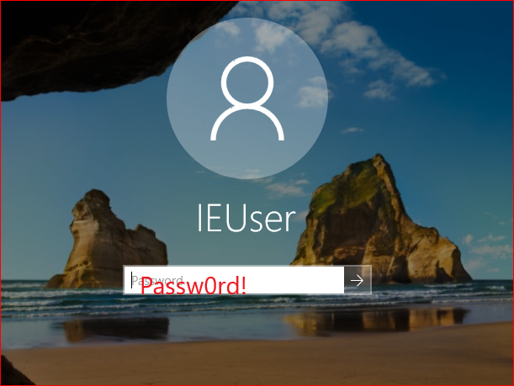

Slide 21
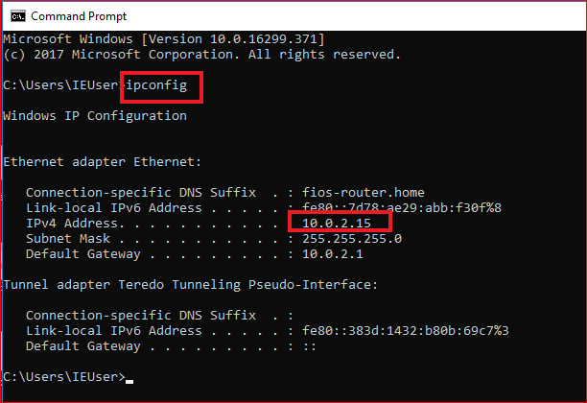

Slide 22
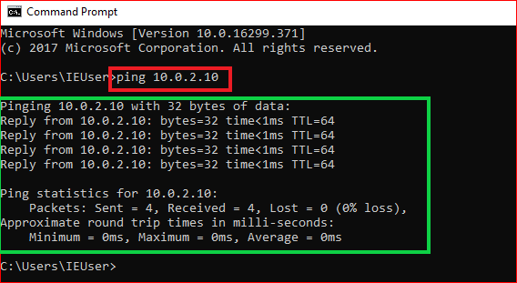
Confirm victim/Window 10 and attacker/kali in the same network

Slide 23
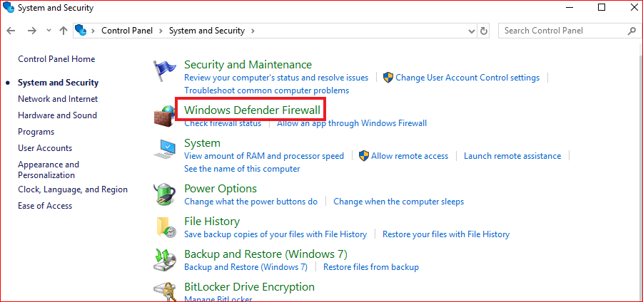
Turn off Firewall

Slide 24
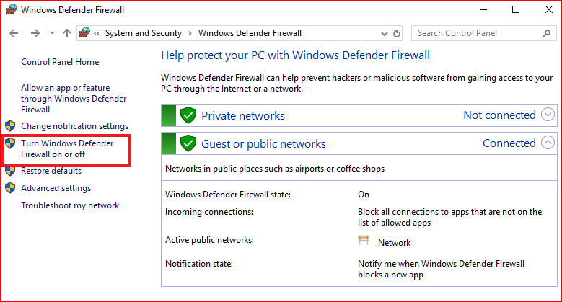

Slide 25
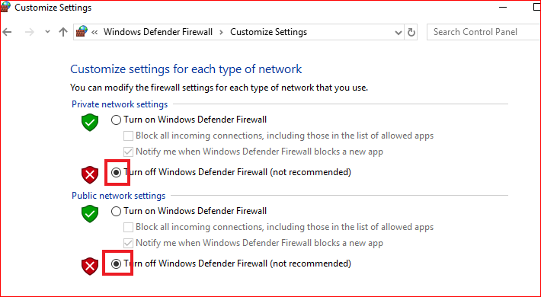

Slide 26
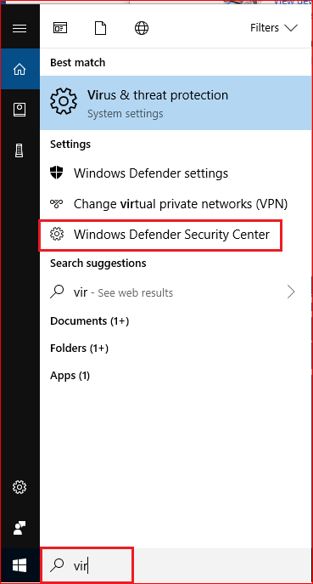
Turn off virus protection

Slide 27
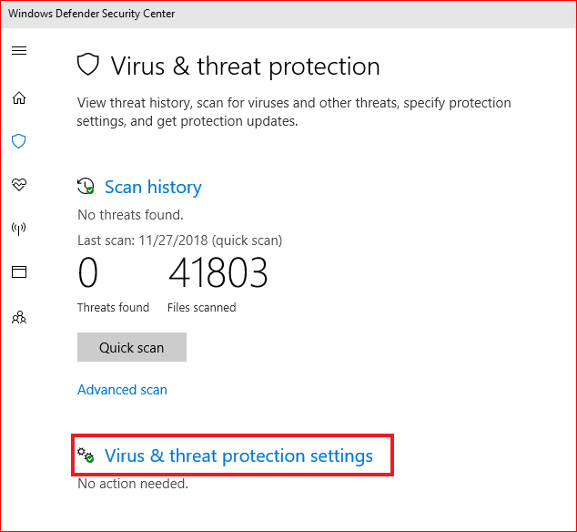

Slide 28
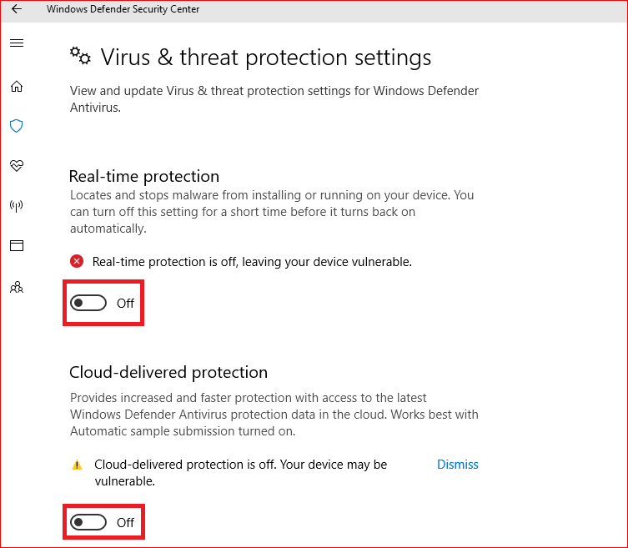

Slide 29
Victim click the backdoor

Slide 30
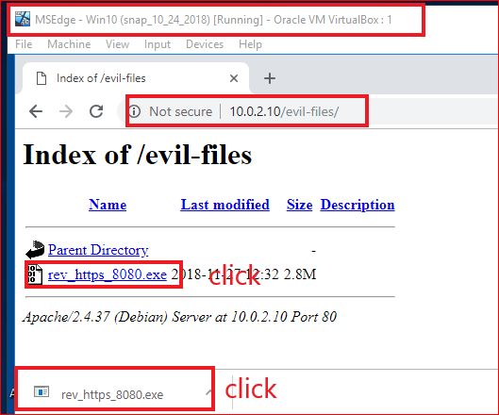
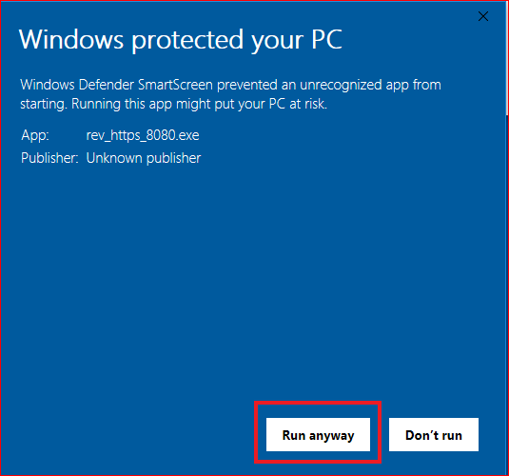

Slide 31
Attack gain access to victim’s PC

Slide 32
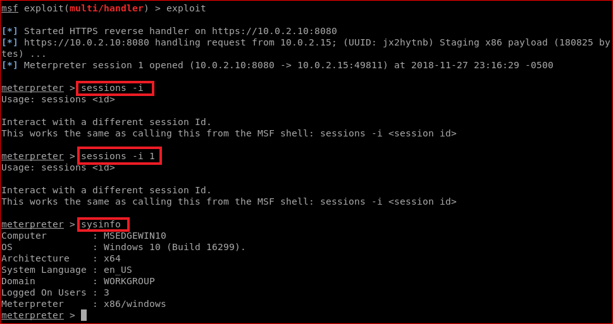

Slide 33
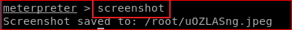
Attack take screenshots of victim’s PC

Slide 34
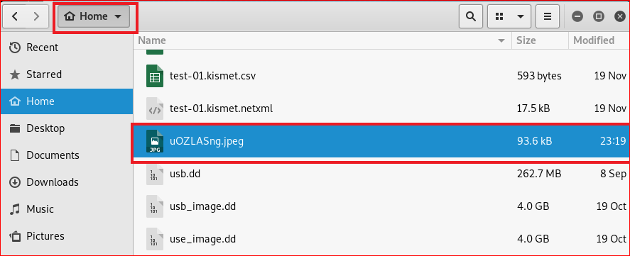
Show victim’s screenshots

Slide 35
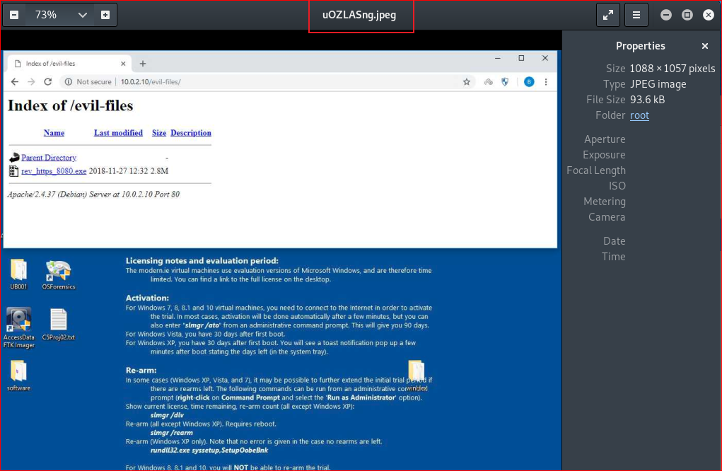

Slide 36
Things you need to try
keyscan_start (enable key logger)
(in Window VM, open facebook, type your password)
keyscan_dump (what did you see?)
keyscan_stop

Slide 37
Questions
Can you change the backdoor and bypass Windows security check? Try and show me the results.

